Slide 1
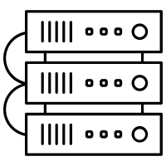

















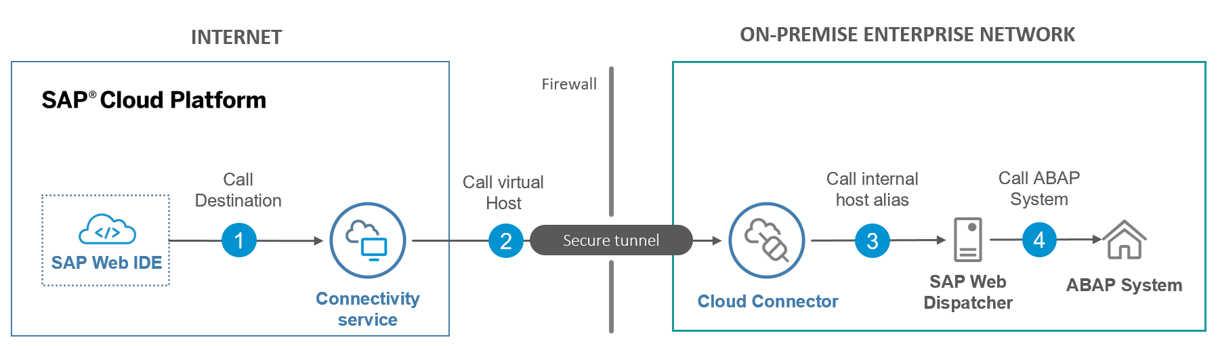


Business Objects Private Cloud Edition Managed Service Deployment
On Premise
Azure Region SA North
Standard Bank Subscription
vNet
Peering
Standard Finance Subscription
Identity Management Subnet
Azure Services
Azure Active Directory
Mfa
Local Gateway
Shared Services Subnet
SAP Subscription
Notes:
VPN to be configured by both Standard Bank and SAP
Cloudflare to be configured by Standard Bank, and SAP will be required to configure the App Gateway to connect to Cloudflare
Standard Bank and SAP will need to configure SSO
The dedicated virtual network is created using Std Bank private CIDR address range which is non-overlapping with the on-premise network.
The Name resolution is configured by creating a dedicated zone in internal DNS domain (Our current DNS :Prod https://financeportal.standardbank.co.za/BOE/BI
QA: https://financeportalqa.standardbank.co.za/BOE/BI
VPN
Gateway Subnet
VNet
VNet Gateway Subnet
Application Subnet
Azure Express Route
VNet Gateway
Standard Bank’s 3rd party connectivity hub.
Mandatory for routing via Express Route
Data Traffic
Internet
Configuration Traffic
VNet Gateway
App Gateway Subnet
User Web Traffic
App Gateway
Internet user
Notes:
https://azure.microsoft.com/en-us/pricing/details/bot-services/
https://azure.microsoft.com/en-us/updates/application-insights-availability-in-south-africa-north/
https://docs.microsoft.com/en-us/azure/bot-service/bot-service-manage-analytics?view=azure-bot-service-4.0
https://azure.microsoft.com/en-us/pricing/details/cosmos-db/

